Slide 1
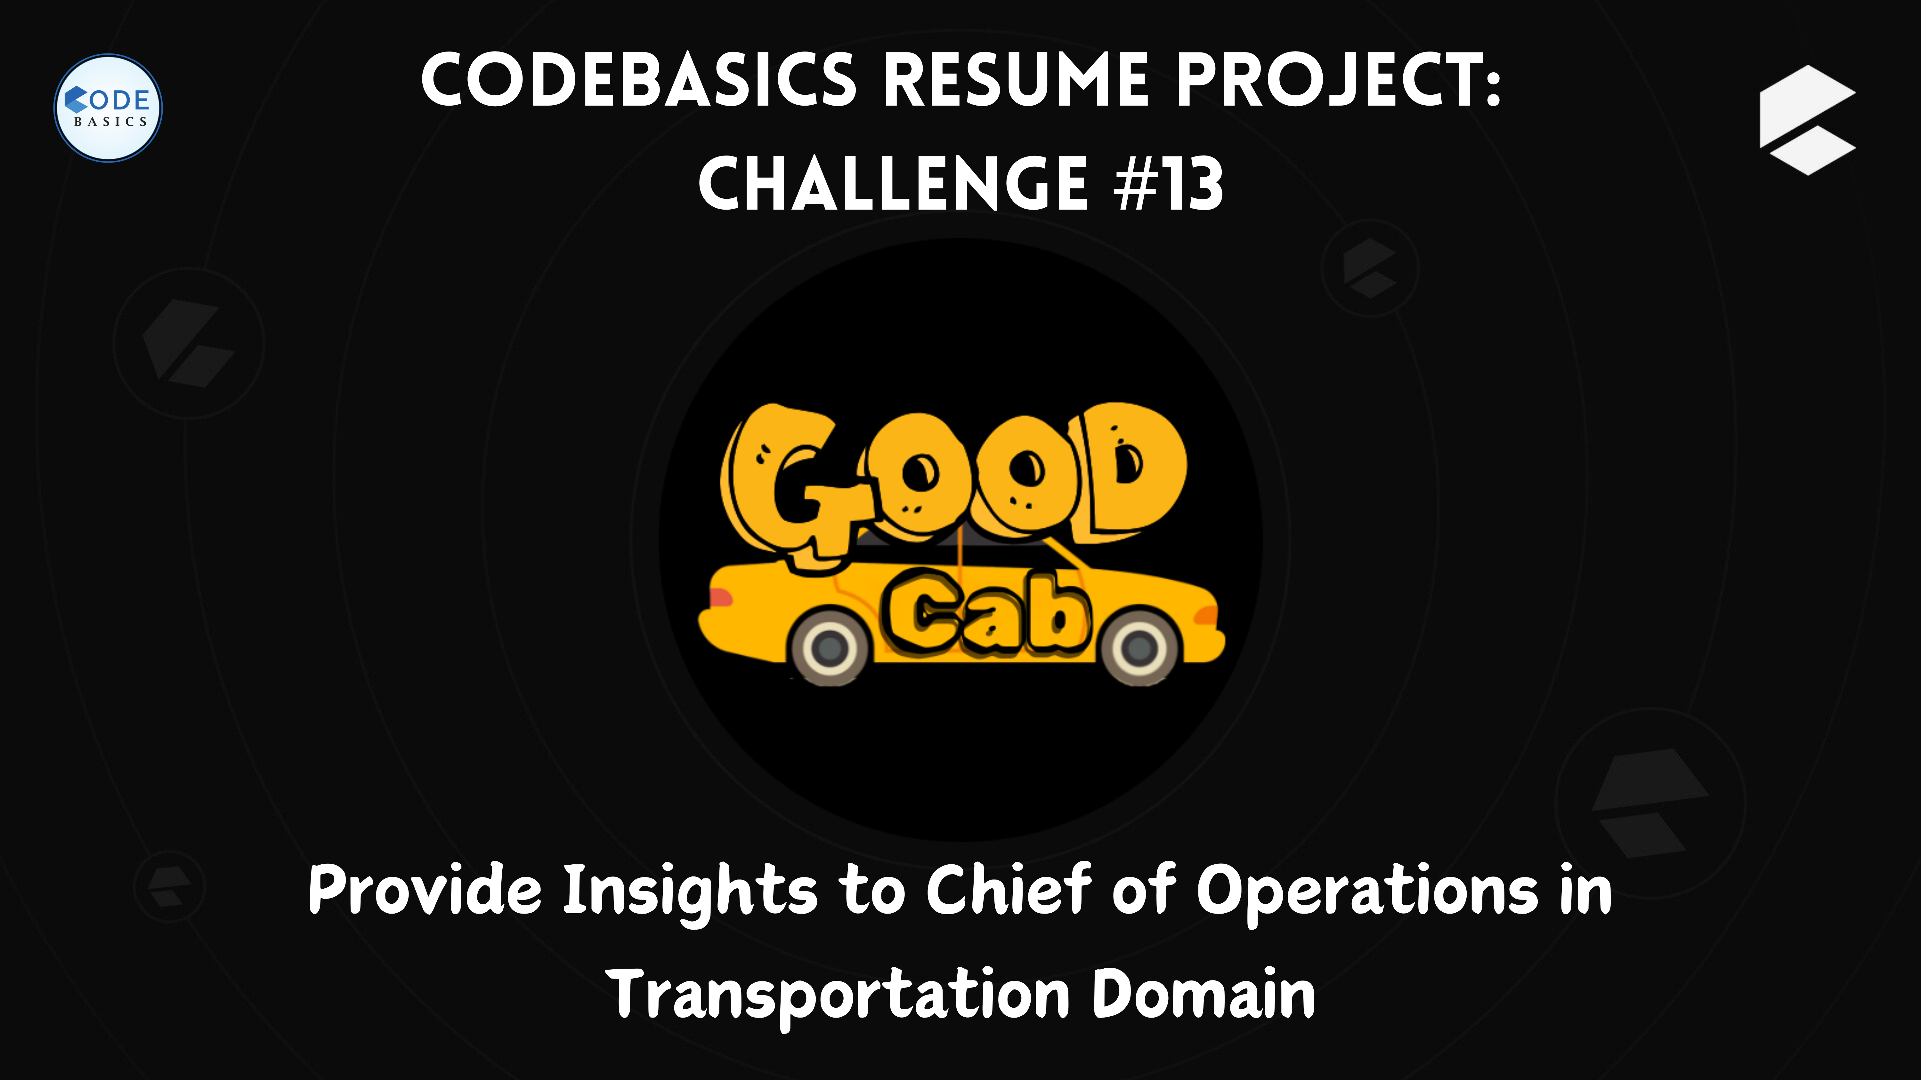

Slide 2
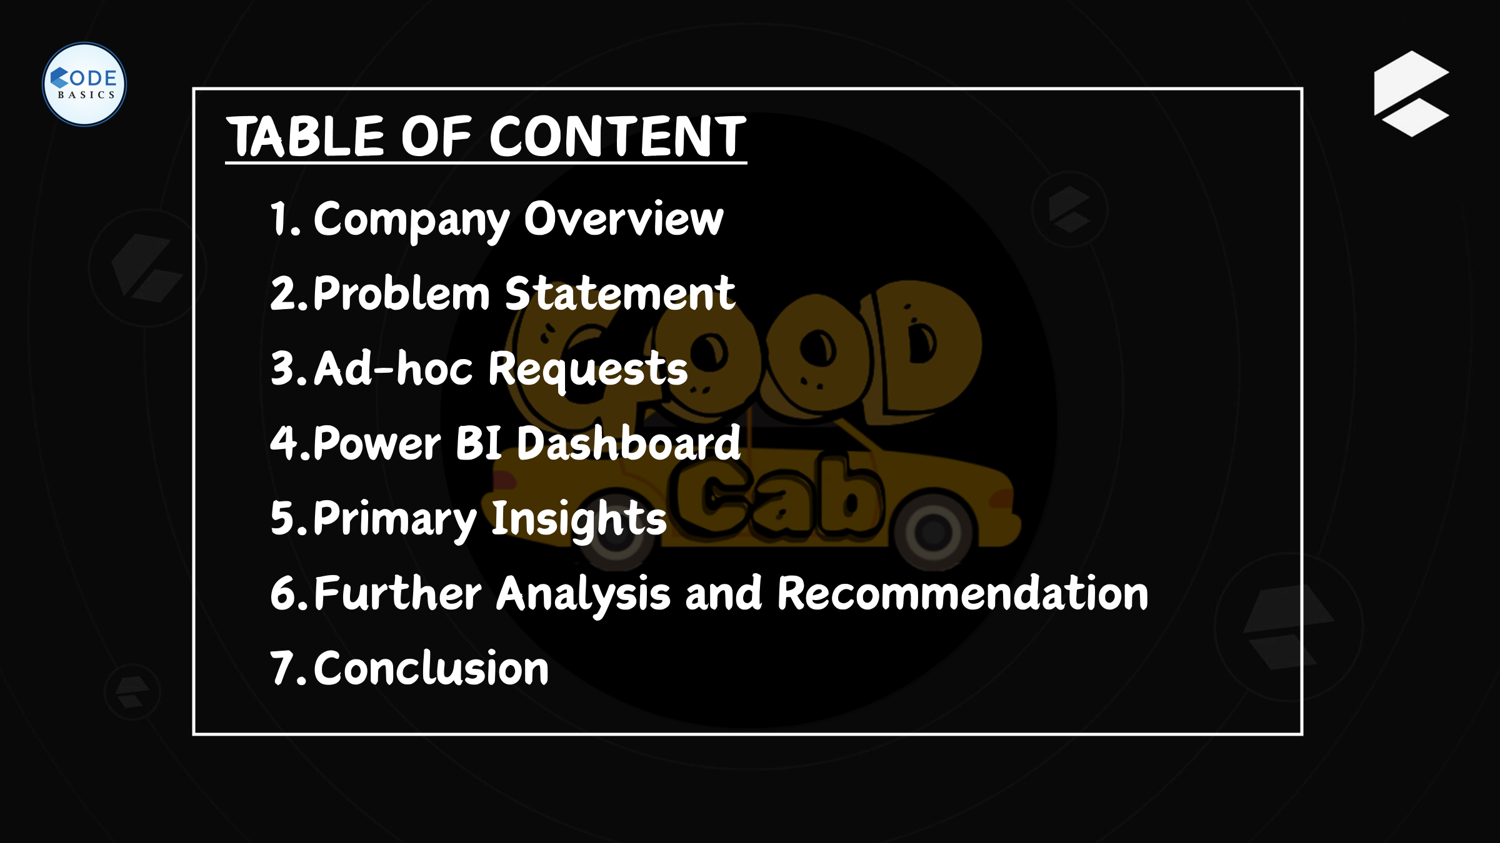

Slide 3

Company Overview
Company Overview:
Established: Goodcabs was founded two years ago, marking a new entrant in the competitive cab service industry.
Market Focus: Unlike many other providers, Goodcabs concentrates its efforts on tier-2 cities in India, where there is significant demand but less saturation.
Unique Selling Point: Goodcabs stands out by its commitment to supporting local drivers. This support helps them to make a sustainable living in their hometowns.
Mission:
Supporting Local Drivers: Goodcabs is dedicated to creating sustainable livelihoods for local drivers.
Excellent Passenger Service: The company ensures high standards of service to its passengers, combining reliability with comfort and safety.

Slide 4
Company Overview
Current Operations:
Presence in Tier-2 Cities: Goodcabs operates in ten tier-2 cities across India. This strategic choice allows the company to tap into markets that are often overlooked by larger competitors.
Local Impact: By focusing on tier-2 cities, Goodcabs plays a significant role in the local economies, providing job opportunities and boosting income for local drivers.
2024 Performance Targets:
Driving Growth: Goodcabs has set ambitious targets to expand its market share and enhance its service offerings.
Improving Passenger Satisfaction: The company is committed to ensuring passengers have a consistently positive experience, reflected in their satisfaction scores.

Slide 5
Problem Statement
Problem:
Objective: Goodcabs aims to drive growth and improve passenger satisfaction in its operations across ten tier-2 cities in India. However, to achieve these ambitious targets for 2024, the company needs to thoroughly understand and improve its performance across several key metrics.
Key Challenges:
Trip Volume: Understanding fluctuations and patterns in trip volume to identify growth opportunities and optimize operations.
Passenger Satisfaction: Ensuring high levels of passenger satisfaction by addressing feedback and improving service quality.
Repeat Passenger Rate: Increasing the rate of repeat passengers to build a loyal customer base.
Trip Distribution: Balancing trip distribution across different areas to ensure efficient service coverage and meeting demand.
New vs. Repeat Passengers: Maintaining a healthy balance between acquiring new passengers and retaining existing ones to sustain long-term growth.

Slide 6

Ad-hoc Requests
Business Request - 1: City-Level Fare and Trip Summary Report
Generate a report that displays the total trips, average fare per km, average fare per trip, and the percentage contribution of each city's trips to the overall trips. This report will help in assessing trip volume, pricing efficiency, and each City's contribution to the overall trip count.
Fields:
city name
total trips
avg_fare_per_km
avg_fare_per_trip
% contribution to total _ trips
QUERY SOLUTION
city_name | total_trips | avg_fare_per_km | avg_fare_per_trip | per_contribution_to_total_trips
Jaipur | 76888 | 16.12 | 483.92 | 18.05%
Lucknow | 64299 | 11.76 | 147.18 | 15.10%
Surat | 54843 | 10.66 | 117.27 | 12.88%
Kochi | 50702 | 13.93 | 335.25 | 11.90%
Indore | 42456 | 10.9 | 179.84 | 9.97%
Chandigarh | 38981 | 12.06 | 283.69 | 9.15%
Vadodara | 32026 | 10.29 | 118.57 | 7.52%
Visakhapatnam | 28366 | 12.53 | 282.67 | 6.66%
Coimbatore | 21104 | 11.15 | 166.98 | 4.96%
Mysore | 16238 | 15.14 | 249.71 | 3.81%
avg_dist_per_trip
30.02
12.52
11.00
24.07
16.50
23.52
11.52
22.56
14.98
16.49

Slide 7
Ad-hoc Requests
Business Request • 2: Monthly City-Level Trips Target Performance Report
Generate a report that evaluates the target performance for trips at the monthly and city level. For each city and month, compare the actual total trips with the target trips and categorise the performance as follows:
• If actual trips are greater than target trips, mark it as "Above Target".
• If actual trips are less than or equal to target trips, mark it as "Below Target".
Additionally, calculate the % difference between actual and target trips to quantify the
performance gap.
Fields:
City name
month name
actual_trips
target trips
performance status
% difference
QUERY SOLUTION

Slide 8
Ad-hoc Requests
city_name | month_name | actual_trips | total_target_trips | performance_status | perc_difference
Visakhapatnam | January | 4468 | 4500 | Below Target | -0.72%
Chandigarh | January | 6810 | 7000 | Below Target | -2.79%
Surat | January | 8358 | 9000 | Below Target | -7.68%
Vadodara | January | 4775 | 6000 | Below Target | -25.65%
Mysore | January | 2485 | 2000 | Above Target | 19.52%
Kochi | January | 7344 | 7500 | Below Target | -2.12%
Indore | January | 6737 | 7000 | Below Target | -3.90%
Jaipur | January | 14976 | 13000 | Above Target | 13.19%
Coimbatore | January | 3651 | 3500 | Above Target | 4.14%
Lucknow | January | 10858 | 13000 | Below Target | -19.73%
Visakhapatnam | February | 4793 | 4500 | Above Target | 6.11%
Chandigarh | February | 7387 | 7000 | Above Target | 5.24%
Surat | February | 9069 | 9000 | Above Target | 0.76%
Vadodara | February | 5228 | 6000 | Below Target | -14.77%
Mysore | February | 2668 | 2000 | Above Target | 25.04%
Kochi | February | 7688 | 7500 | Above Target | 2.45%
Indore | February | 7210 | 7000 | Above Target | 2.91%
Jaipur | February | 15872 | 13000 | Above Target | 18.09%
Coimbatore | February | 3404 | 3500 | Below Target | -2.82%
Lucknow | February | 12060 | 13000 | Below Target | -7.79%
Visakhapatnam | March | 4877 | 4500 | Above Target | 7.73%
Chandigarh | March | 6569 | 7000 | Below Target | -6.56%
Surat | March | 9267 | 9000 | Above Target | 2.88%
Vadodara | March | 5598 | 6000 | Below Target | -7.18%
Mysore | March | 2633 | 2000 | Above Target | 24.04%
Kochi | March | 9495 | 7500 | Above Target | 21.01%
Indore | March | 7019 | 7000 | Above Target | 0.27%
Jaipur | March | 13317 | 13000 | Above Target | 2.38%
Coimbatore | March | 3680 | 3500 | Above Target | 4.89%
Lucknow | March | 11224 | 13000 | Below Target | -15.82%
city_name | month_name | actual_trips | total_target_trips | performance_status | perc_difference
Visakhapatnam | April | 4938 | 5000 | Below Target | -1.26%
Chandigarh | April | 5566 | 6000 | Below Target | -7.80%
Surat | April | 9831 | 10000 | Below Target | -1.72%
Vadodara | April | 5941 | 6500 | Below Target | -9.41%
Mysore | April | 2603 | 2500 | Above Target | 3.96%
Kochi | April | 9762 | 9000 | Above Target | 7.81%
Indore | April | 7415 | 7500 | Below Target | -1.15%
Jaipur | April | 11406 | 9500 | Above Target | 16.71%
Coimbatore | April | 3661 | 3500 | Above Target | 4.40%
Lucknow | April | 10212 | 11000 | Below Target | -7.72%
Visakhapatnam | May | 4812 | 5000 | Below Target | -3.91%
Chandigarh | May | 6620 | 6000 | Above Target | 9.37%
Surat | May | 9774 | 10000 | Below Target | -2.31%
Vadodara | May | 5799 | 6500 | Below Target | -12.09%
Mysore | May | 3007 | 2500 | Above Target | 16.86%
Kochi | May | 10014 | 9000 | Above Target | 10.13%
Indore | May | 7787 | 7500 | Above Target | 3.69%
Jaipur | May | 11475 | 9500 | Above Target | 17.21%
Coimbatore | May | 3550 | 3500 | Above Target | 1.41%
Lucknow | May | 9705 | 11000 | Below Target | -13.34%
Visakhapatnam | June | 4478 | 5000 | Below Target | -11.66%
Chandigarh | June | 6029 | 6000 | Above Target | 0.48%
Surat | June | 8544 | 10000 | Below Target | -17.04%
Vadodara | June | 4685 | 6500 | Below Target | -38.74%
Mysore | June | 2842 | 2500 | Above Target | 12.03%
Kochi | June | 6399 | 9000 | Below Target | -40.65%
Indore | June | 6288 | 7500 | Below Target | -19.27%
Jaipur | June | 9842 | 9500 | Above Target | 3.47%
Coimbatore | June | 3158 | 3500 | Below Target | -10.83%
Lucknow | June | 10240 | 11000 | Below Target | -7.42%

Slide 9
Ad-hoc Requests
Business Request • 3: City-Level Repeat Passenger Trip Frequency Report
Generate a report that shows the percentage distribution of repeat passengers by the number of trips they have taken in each city. Calculate the percentage of repeat passengers who took 2 trips, 3 trips, and so on, up to 10 trips.
Each column should represent a trip count category, displaying the percentage of repeat passengers who fall into that category out of the total repeat passengers for that city.
This report will help identify cities with high repeat trip frequency, which can indicate strong
customer loyalty or frequent usage patterns.
• Fields: city name, 2-Trips, 3-Trips, 4-Trips, 5-Trips, 6-Trips, 7-Trips, 8-Trips, 9-Trips,
10-Trips
QUERY SOLUTION
city_name | 2-Trips | 3-Trips | 4-Trips | 5-Trips | 6-Trips | 7-Trips | 8-Trips | 9-Trips | 10-Trips
Visakhapatnam | 51.25 | 24.96 | 9.98 | 5.44 | 3.19 | 1.98 | 1.39 | 0.88 | 0.92
Jaipur | 50.14 | 20.73 | 12.12 | 6.29 | 4.13 | 2.52 | 1.9 | 1.2 | 0.97
Mysore | 48.75 | 24.44 | 12.73 | 5.82 | 4.06 | 1.76 | 1.42 | 0.54 | 0.47
Kochi | 47.67 | 24.35 | 11.81 | 6.48 | 3.91 | 2.11 | 1.65 | 1.21 | 0.81
Indore | 34.34 | 22.69 | 13.4 | 10.34 | 6.85 | 5.24 | 3.26 | 2.38 | 1.51
Chandigarh | 32.31 | 19.25 | 15.74 | 12.21 | 7.42 | 5.48 | 3.47 | 2.33 | 1.79
Coimbatore | 11.21 | 14.82 | 15.56 | 20.62 | 17.64 | 10.47 | 6.15 | 2.31 | 1.22
Vadodara | 9.87 | 14.17 | 16.52 | 18.06 | 19.08 | 12.86 | 5.78 | 2.05 | 1.61
Surat | 9.76 | 14.26 | 16.55 | 19.75 | 18.45 | 11.89 | 6.24 | 1.74 | 1.35
Lucknow | 9.66 | 14.77 | 16.2 | 18.42 | 20.18 | 11.33 | 6.43 | 1.91 | 1.1

Slide 10
Ad-hoc Requests
Business Request •4: Identify Cities with Highest and Lowest Total New Passengers
Generate a report that calculates the total new passengers for each City and ranks them based on this value. Identify the top 3 cities with the highest number of new passengers as well as the bottom 3 cities with the lowest number of new passengers, categorising them as "Top 3" or "Bottom 3" accordingly.
Fields
city
total
city
name
_new_passengers
category ("Top 3" or "Bottom 3')
QUERY SOLUTION
Top 3 / Bottom 3 | city_name | total_new_passengers
1 | Jaipur | 55538
2 | Kochi | 34042
3 | Lucknow | 25857
Top 3 / Bottom 3 | city_name | total_new_passengers
10 | Coimbatore | 11065
9 | Mysore | 13158
8 | Vadodara | 14473

Slide 11
Ad-hoc Requests
Business Request 5: Identify Month with Highest Revenue for Each City
Generate a report that identifies the month with the highest revenue for each City. For each city, display the month_name, the revenue amount for that month, and the percentage contribution of that month's revenue to the city's total revenue.
Fields
city name
highest_revenue month
revenue
percentage contribution (%)
QUERY SOLUTION
city_name | highest_revenue_month | highest_revenue | percentage_contribution | total_revenue
Jaipur | February | 7747202 | 20.82% | 37207497
Kochi | May | 3333746 | 19.61% | 16997596
Chandigarh | February | 2108290 | 19.07% | 11058401
Lucknow | February | 1777269 | 18.78% | 9463551
Vadodara | April | 706250 | 18.60% | 3797200
Mysore | May | 745170 | 18.38% | 4054745
Indore | May | 1380996 | 18.09% | 7635228
Surat | April | 1154909 | 17.96% | 6431599
Coimbatore | April | 612431 | 17.38% | 3523992
Visakhapatnam | April | 1390682 | 17.34% | 8018282

Slide 12
Ad-hoc Requests
Business Request • 6: Repeat Passenger Rate Analysis
Generate a report that calculates two metrics:
I. Monthly Repeat Passenger Rate. Calculate the repeat passenger rate for each city and month by comparing the number of repeat passengers to the total passengers.
2. City-wide Repeat Passenger Rate. Calculate the overall repeat passenger rate for each city, considering all passengers across months.
These metrics Will provide insights into monthly repeat trends as well as the overall repeat
behaviour for each city
Fields:
city name
month
total_passengers
repeat_passengers
monthly repeat_passenger rate (0/0): Repeat passenger rate at the city and month level
city_repeat_passenger rate (%): Overall repeat passenger rate for each city,
aggregated across months
QUERY SOLUTION

Slide 13
Ad-hoc Requests
city_name | month | total_passengers | repeat_passengers | monthly_repeat_passenger_rate | city_repeat_passenger_rate
Chandigarh | January | 4640 | 720 | 15.52 | 14.20
Chandigarh | February | 4957 | 853 | 17.21 | 16.82
Chandigarh | March | 4100 | 872 | 21.27 | 17.20
Chandigarh | April | 3285 | 789 | 24.02 | 15.56
Chandigarh | May | 3699 | 969 | 26.20 | 19.11
Chandigarh | June | 3297 | 867 | 26.30 | 17.10
Coimbatore | January | 2214 | 392 | 17.71 | 15.37
Coimbatore | February | 1993 | 346 | 17.36 | 13.56
Coimbatore | March | 1965 | 427 | 21.73 | 16.74
Coimbatore | April | 1722 | 480 | 27.87 | 18.82
Coimbatore | May | 1543 | 504 | 32.66 | 19.76
Coimbatore | June | 1628 | 402 | 24.69 | 15.76
Indore | January | 3876 | 1033 | 26.65 | 14.32
Indore | February | 3981 | 1103 | 27.71 | 15.29
Indore | March | 3833 | 1091 | 28.46 | 15.12
Indore | April | 3646 | 1295 | 35.52 | 17.95
Indore | May | 3591 | 1563 | 43.53 | 21.66
Indore | June | 3152 | 1131 | 35.88 | 15.67
Jaipur | January | 11845 | 1422 | 12.01 | 14.69
Jaipur | February | 12450 | 1661 | 13.34 | 17.16
Jaipur | March | 9257 | 1840 | 19.88 | 19.00
Jaipur | April | 7856 | 1736 | 22.10 | 17.93
Jaipur | May | 7174 | 1842 | 25.68 | 19.02
Jaipur | June | 6956 | 1181 | 16.98 | 12.20
Kochi | January | 5660 | 795 | 14.05 | 10.42
Kochi | February | 5372 | 1005 | 18.71 | 13.18
Kochi | March | 6213 | 1348 | 21.70 | 17.68
Kochi | April | 6515 | 1576 | 24.19 | 20.67
Kochi | May | 6222 | 1853 | 29.78 | 24.30
Kochi | June | 4060 | 1049 | 25.84 | 13.76
city_name | month | total_passengers | repeat_passengers | monthly_repeat_passenger_rate | city_repeat_passenger_rate
Lucknow | January | 4896 | 1431 | 29.23 | 14.91
Lucknow | February | 5188 | 1659 | 31.98 | 17.29
Lucknow | March | 4781 | 1622 | 33.93 | 16.90
Lucknow | April | 3807 | 1496 | 39.30 | 15.59
Lucknow | May | 3487 | 1662 | 47.66 | 17.32
Lucknow | June | 3698 | 1727 | 46.70 | 18.00
Mysore | January | 2129 | 172 | 8.08 | 11.65
Mysore | February | 2290 | 183 | 7.99 | 12.39
Mysore | March | 2194 | 208 | 9.48 | 14.08
Mysore | April | 2072 | 236 | 11.39 | 15.98
Mysore | May | 2270 | 349 | 15.37 | 23.63
Mysore | June | 2203 | 329 | 14.93 | 22.27
Surat | January | 3616 | 1184 | 32.74 | 13.71
Surat | February | 3567 | 1313 | 36.81 | 15.20
Surat | March | 3440 | 1494 | 43.43 | 17.30
Surat | April | 3394 | 1551 | 45.70 | 17.96
Surat | May | 3217 | 1606 | 49.92 | 18.59
Surat | June | 3030 | 1490 | 49.17 | 17.25
Vadodara | January | 2633 | 544 | 20.66 | 12.52
Vadodara | February | 2756 | 610 | 22.13 | 14.04
Vadodara | March | 2522 | 759 | 30.10 | 17.46
Vadodara | April | 2499 | 862 | 34.49 | 19.83
Vadodara | May | 2256 | 868 | 38.48 | 19.97
Vadodara | June | 1807 | 703 | 38.90 | 16.18
Visakhapatnam | January | 3163 | 650 | 20.55 | 12.73
Visakhapatnam | February | 3170 | 790 | 24.92 | 15.47
Visakhapatnam | March | 3093 | 923 | 29.84 | 18.07
Visakhapatnam | April | 2837 | 992 | 34.97 | 19.42
Visakhapatnam | May | 2890 | 951 | 32.91 | 18.62
Visakhapatnam | June | 2702 | 802 | 29.68 | 15.70

Slide 14
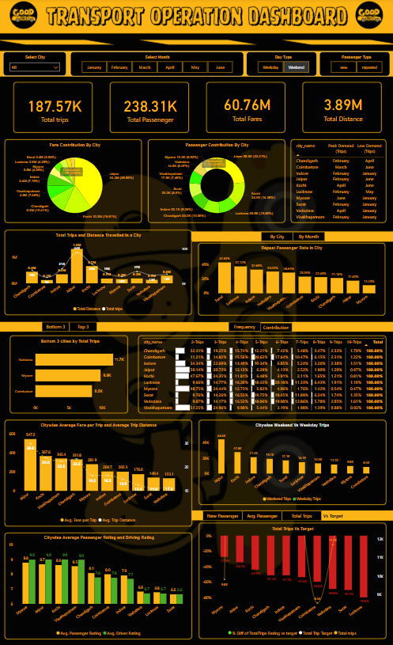
Power BI Dashboard
View Dashboard in Power BI

Slide 15
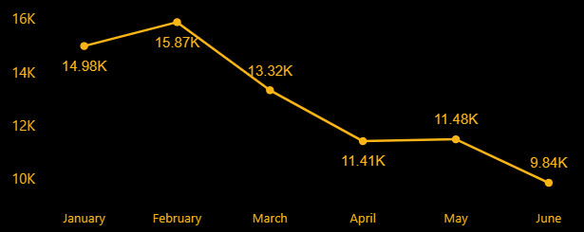
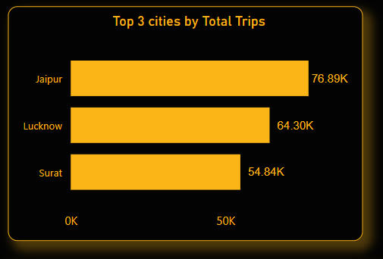
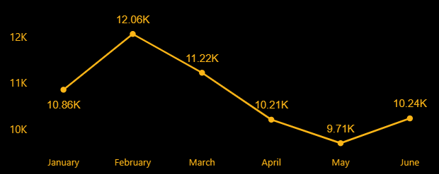
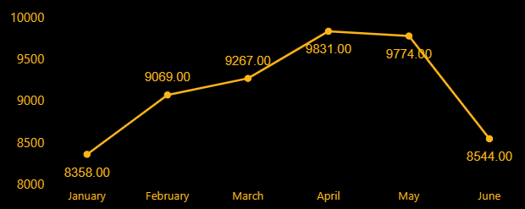
Primary Insights
1. Top and Bottom Performing Cities
Jaipur
Lucknow
Insights:
Jaipur ranks highest among all cities in terms of the maximum number of trips traveled, with 76.89K trips within the city, followed by Lucknow with 64.30K trips and Surat with 54.84K. However, the number of trips in Jaipur and Lucknow has been decreasing over time but it performed better in June.
In all three cities, only Lucknow performed better in June compared to May, with trips increasing from 9.71K to 10.24K. In contrast, trips in Surat dropped from 9.74K to 8.54K, and in Jaipur, trips decreased from 11.48K to 9.84K.
Surat

Slide 16
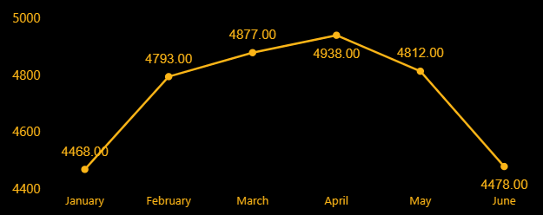
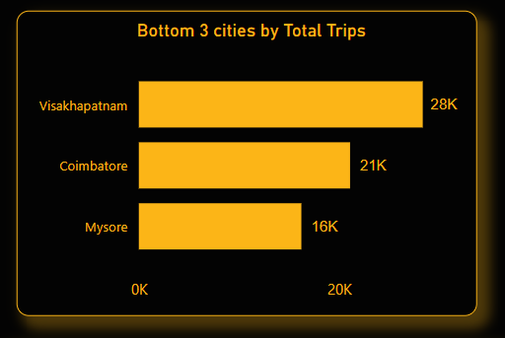
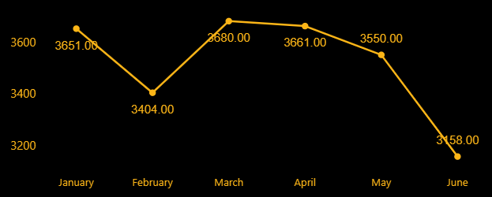
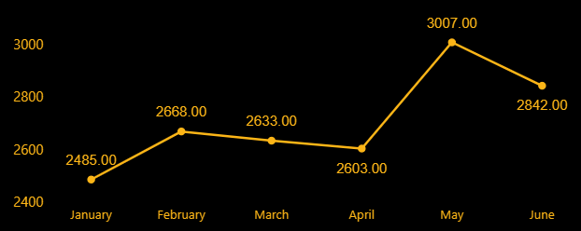
Primary Insights
1. Top and Bottom Performing Cities
Visakhapatnam
Coimbatore
Insights:
Visakhapatnam ranks highest among bottom 3 cities in terms of the maximum number of trips traveled, with 28K trips within the city, followed by Coimbatore with 21K trips and Mysore with 16K.
In all three cities, No one performs better in June as compare to May but Surat trend line shows better improvement than Coimbatore and Visakhapatnam
Surat

Slide 17
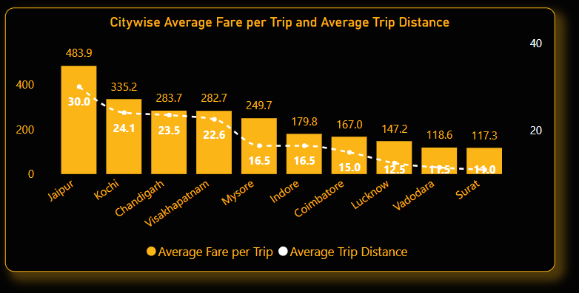
Primary Insights
2. Average Fare per Trip by City
Insights:
Jaipur ranks highest among all cities in terms of average fare per trip, with 483.9 bucks per trip within the city travelled 30 km on an average.
Whereas Surat rank lowest in terms of average fare per trip with 117.3 bucks per trip within the city travelled 11 km on an average.

Slide 18
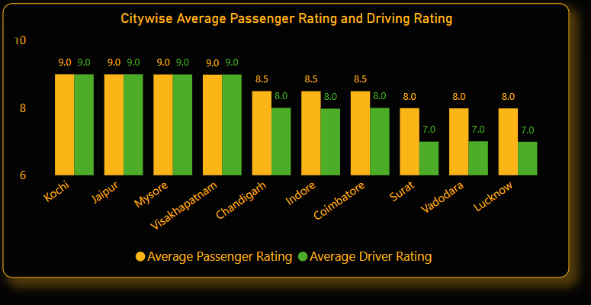
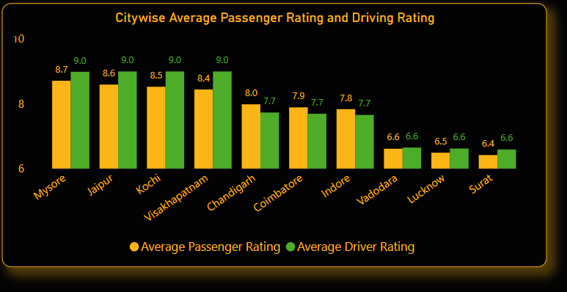
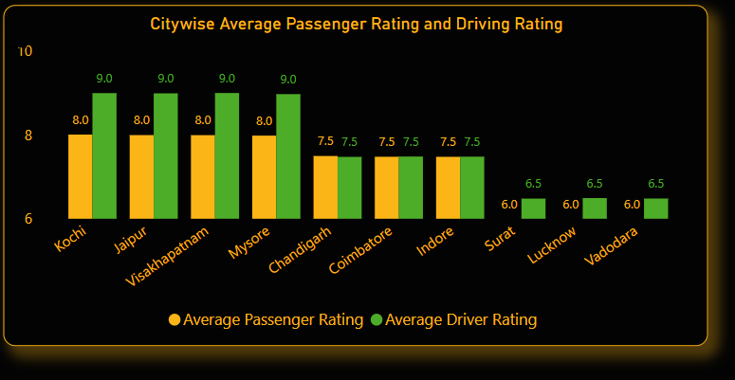
Primary Insights
3. Average Rating by City and Passenger Type
Passenger Type - New
Passenger Type - Overall
Passenger Type - Repeated
Insights:
In the category of Passenger Type – New and Repeated, Kochi ranked highest in both Passenger Rating and Driver Rating, with a score of 9.0 in each. Additionally, in the category of Passenger Type – New, Kochi received a Passenger Rating of 8.0 and a Driver Rating of 9.0.
In the "Passenger Type – New" category, Lucknow ranks the lowest, with a Passenger Rating of 8.0 and a Driving Rating of 7.0. Similarly, in the "Passenger Type – Repeated" category, Vadodara holds the lowest position, scoring 6.0 in Passenger Rating and 6.5 in Driving Rating.
Overall Mysore placed at top in both the rating category while Surat placed at bottom.

Slide 19
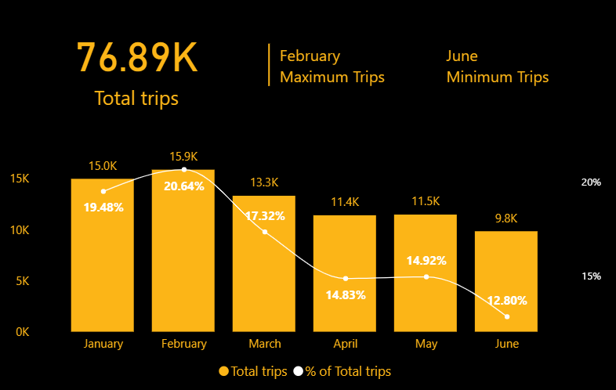
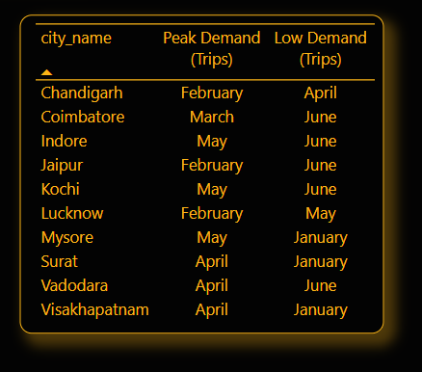
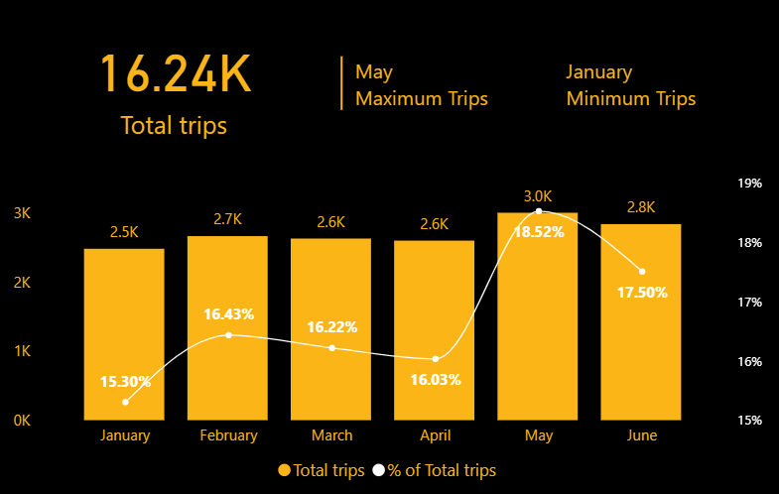
Primary Insights
4. Peak and Low Demand Months by City
Jaipur
Mysore
Insights:
Among all the city maximum trips travelled within a city is Jaipur having peak demand on February and low demand on May.
Mysore having minimum trips traveled within a city having peak demand on February and low demand on June.
February and April are the months having peak demand while January and June are the months having low demand

Slide 20
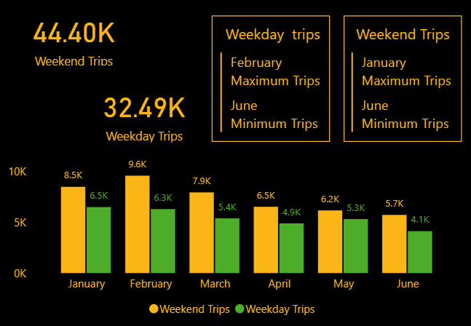
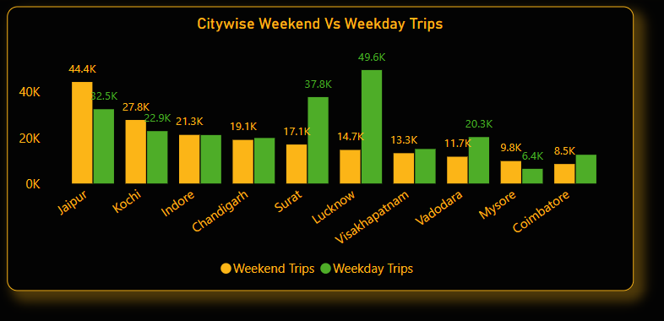
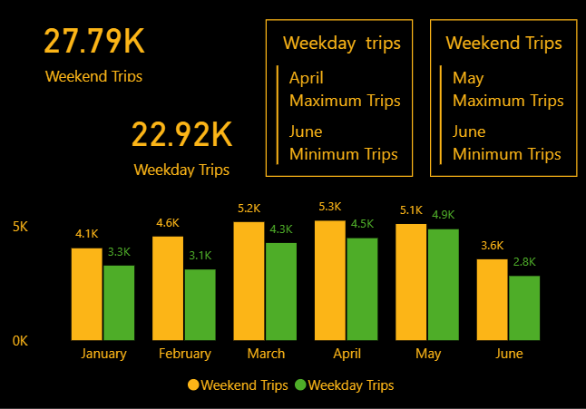
Primary Insights
Jaipur
5. Weekend vs. Weekday Trip Demand by City
Kochi
Key Observations Across Cities:
  Jaipur shows the highest preference for weekend trips with 44.4K weekend trips compared to 32.49K weekday trips.
  Lucknow has a significant preference for weekday trips, with 49.62K weekday trips compared to 14.68K weekend trips.
  Kochi also slightly favors weekends (27.79K weekend trips vs. 22.92K weekday trips).
  Surat, Visakhapatnam, and Vadodara show relatively strong weekday trip demand.

Slide 21
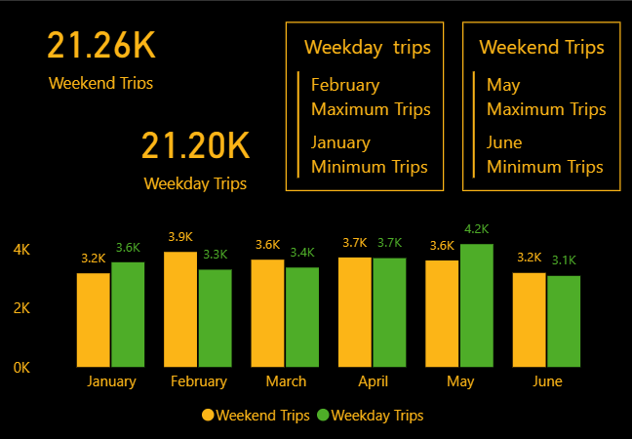
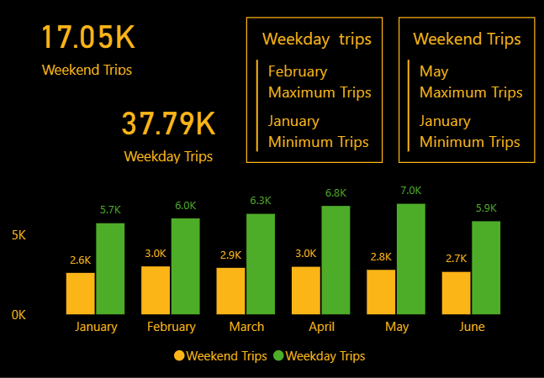
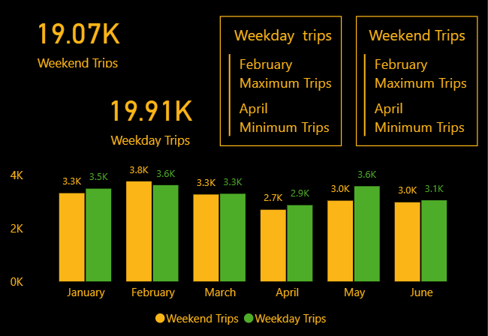
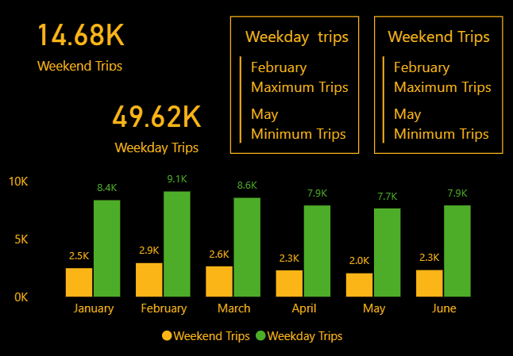
Primary Insights
Indore
Surat
Chandigarh
Lucknow

Slide 22
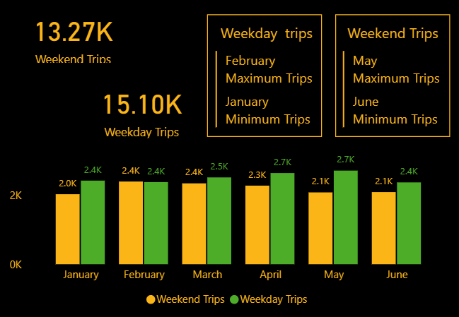
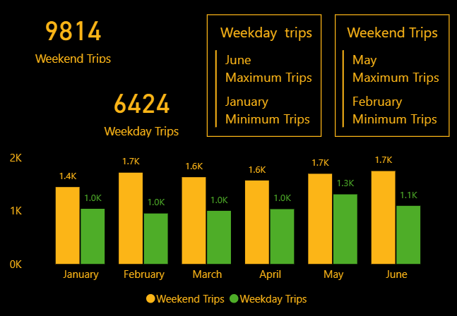

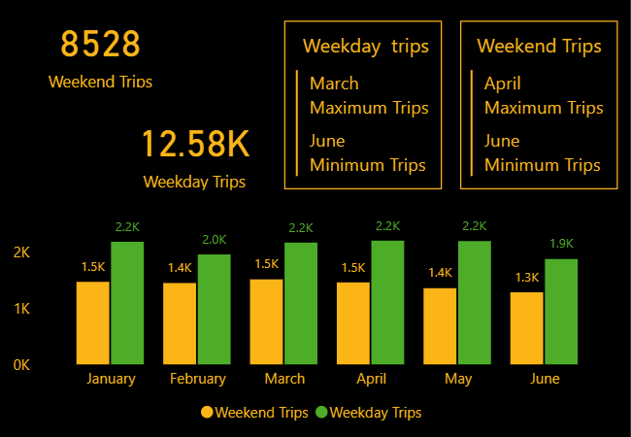
Primary Insights
Visakhapatnam
Mysore
Vadodara
Coimbatore

Slide 23
Primary Insights
2.Cities with a Clear Weekend Preference:
  Jaipur
  Kochi
  Mysore
  Chandigarh (slightly higher weekend demand)
3.Cities with Strong Weekday Preference:
  Lucknow
  Surat
  Vadodara
  Coimbatore
4.Balanced Demand Cities:
  Indore (21.26K weekend trips and 21.20K weekday trips) shows almost equal trip demand on weekends and weekdays.
  Visakhapatnam and Chandigarh have similar trip volumes for weekdays and weekends.
Top 3 City
Weekend- Preferred
Kochi
Jaipur
Weekday- Preferred
Lucknow
Mysore
Surat
Vadodara
Insights for Demand Analysis:
Weekday-dominant cities may be driven by commuting or business-related trips.
Weekend-preferred cities like Jaipur and Mysore could indicate tourism or leisure-based demand.
Balanced cities like Indore show consistent trip demand throughout the week.

Slide 24
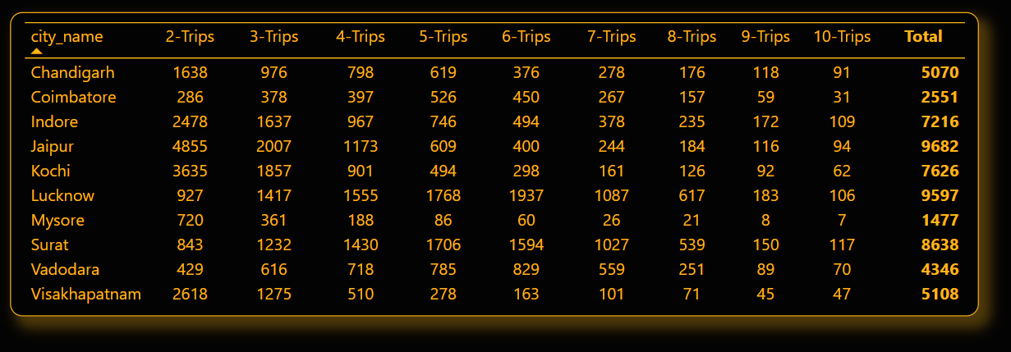
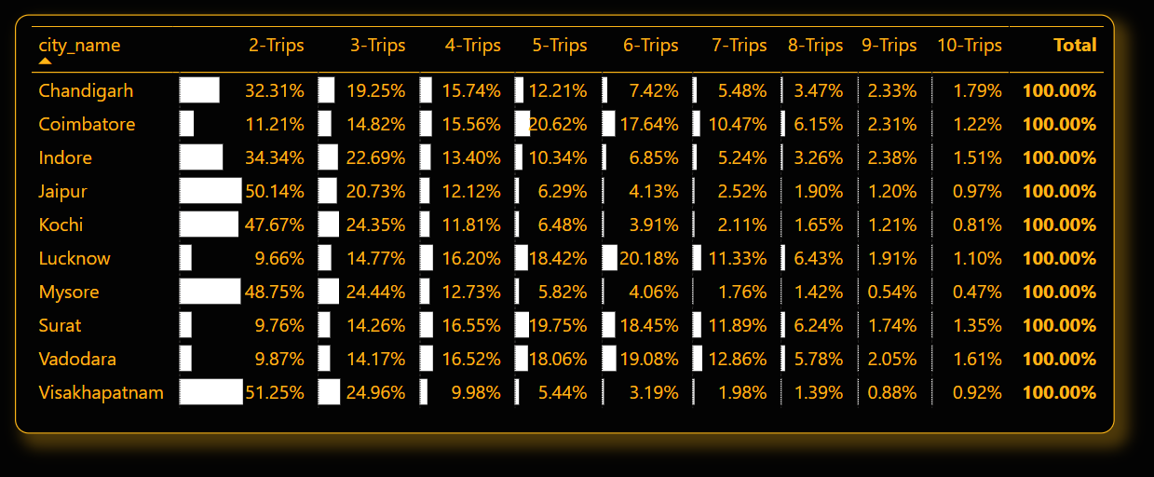
Primary Insights
6. Repeat Passenger Frequency and City Contribution Analysis

Slide 25
Primary Insights
Trip Frequency Analysis:
Cities like Jaipur, Kochi, Mysore and Visakhapatnam show a significantly higher percentage of passengers making 2-trips (e.g., Jaipur 50.14%, Kochi 47.67%, Mysore 48.75%, Visakhapatnam 51.25%).
Cities like Lucknow, Coimbatore, Surat, and Vadodara have more even distributions across higher trip frequencies (e.g., Lucknow: 5+ trips = ~60%).
2.Tourism-Focused Cities:
Jaipur, Mysore, Kochi and Visakhapatnam show a higher concentration in lower trip frequencies (e.g., 2-3 trips). This indicates that most users in these cities may be tourists or occasional travelers.
3.Business-Focused Cities:
Indore, Coimbatore, Lucknow, Surat and Vadodara show higher proportions of passengers making 5+ trips, aligning with business or industrial activity that demands regular commutes.
Key Insights
Tourism Cities:
Passengers in cities like Jaipur and Mysore typically take fewer trips. This aligns with their tourism-oriented economy, where most users are visitors with limited transportation needs.
2.Business/Industrial Cities:
Higher trip frequencies in cities like Surat, Lucknow, and Indore reflect a business-centric focus. These passengers are likely locals using services for daily commutes or work-related travel.
3.Patterns and Recommendations:
Cities with higher 2-3 trip percentages could benefit from tailored packages for short-term visitors, such as tourist passes or discounts.
For cities with higher repeat frequencies (5+ trips), focusing on loyalty programs or subscription-based pricing models could enhance customer retention.

Slide 26
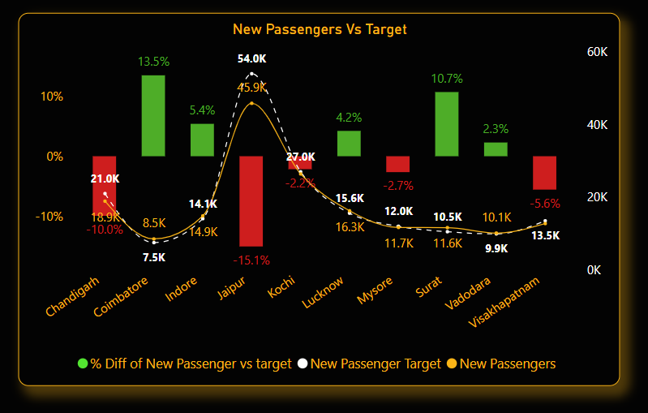
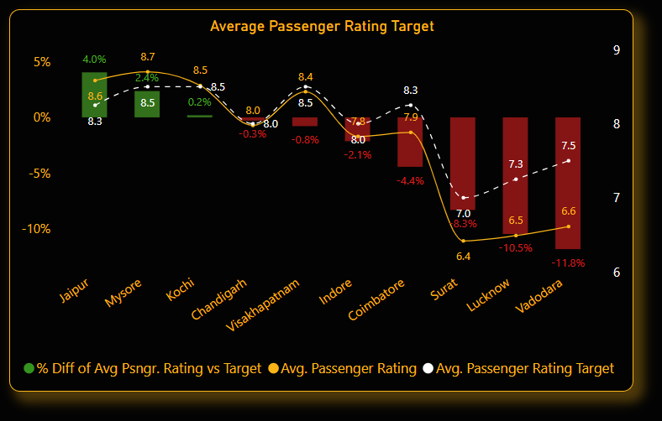
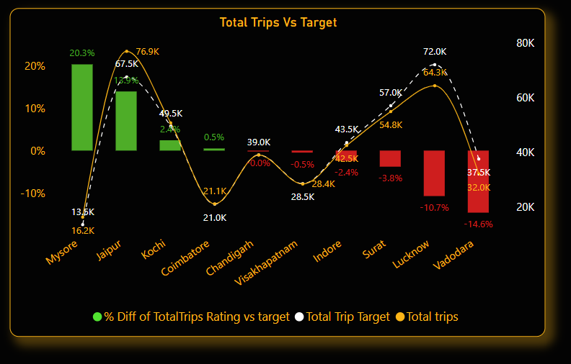
Primary Insights
7. Monthly Target Achievement Analysis for Key Metrics
View Trends in Dashboard

Slide 27
Primary Insights
Total Trips:
Patterns in Total Trips: Business-focused cities like Chandigarh show consistent performance, exceeding targets slightly, indicating stable demand. Tourism-focused cities like Jaipur see slight increases during peak tourist seasons.
New Passengers:
Patterns in New Passengers: Tourism-focused cities, such as Mysore, exhibit higher variability in new passenger numbers, often exceeding targets significantly during tourist seasons. Business-focused cities like Kochi show steady growth.
Average Passenger Rating:
Patterns in Passenger Ratings: Cities such as Visakhapatnam, which may have a mixed focus, maintain high passenger ratings, exceeding targets slightly. Business-focused cities like Indore also meet or slightly exceed targets, reflecting consistent service quality.
City | Target | Actual | Difference | Percentage Difference
Chandigarh | 45,000 | 45,860 | +860 | +1.91%
Jaipur | 26,000 | 26,420 | +420 | +1.62%
City | Target | Actual | Difference | Percentage Difference
Mysore | 11,000 | 11,680 | +680 | +6.18%
Kochi | 26,000 | 26,420 | +420 | +1.62%
City | Target | Actual | Difference | Percentage Difference
Chandigarh | 45,000 | 45,860 | +860 | +1.91%
Jaipur | 26,000 | 26,420 | +420 | +1.62%
City | Target | Actual | Difference | Percentage Difference
Mysore | 11,000 | 11,680 | +680 | +6.18%
Kochi | 26,000 | 26,420 | +420 | +1.62%
City | Target | Actual | Difference | Percentage Difference
Visakhapatnam | 8.3 | 8.5 | +0.2 | +2.41%
Indore | 7.7 | 7.8 | +0.1 | +1.29%

Slide 28
Primary Insights
Analysis by City and Month
Top Performing Cities:
Chandigarh: Consistently exceeds total trips target, indicating strong performance and steady demand.
Mysore: High variability in new passengers, significantly exceeding targets during peak tourist seasons.
Lowest Performing Cities:
Indore: While it meets targets, the increases are marginal, suggesting room for improvement.
Jaipur: Slight increases in total trips, indicative of potential underperformance outside of peak seasons.
Seasonal Patterns
Tourism-Focused Cities: Show significant fluctuations based on tourist seasons, often exceeding targets during high-demand periods (e.g., Mysore). Business-Focused Cities: Demonstrate steady performance with consistent target achievement across metrics (e.g., Chandigarh).
City | Target | Actual | Difference | Percentage Difference
Chandigarh | 45,000 | 45,860 | +860 | +1.91%
Jaipur | 26,000 | 26,420 | +420 | +1.62%
City | Target | Actual | Difference | Percentage Difference
Mysore | 11,000 | 11,680 | +680 | +6.18%
Kochi | 26,000 | 26,420 | +420 | +1.62%

Slide 29
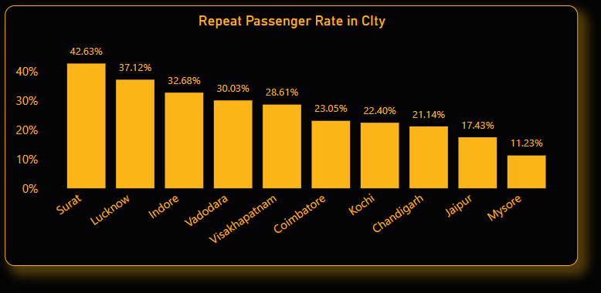
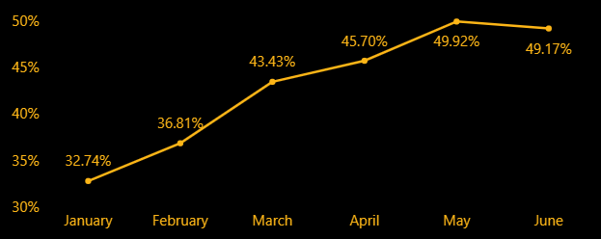
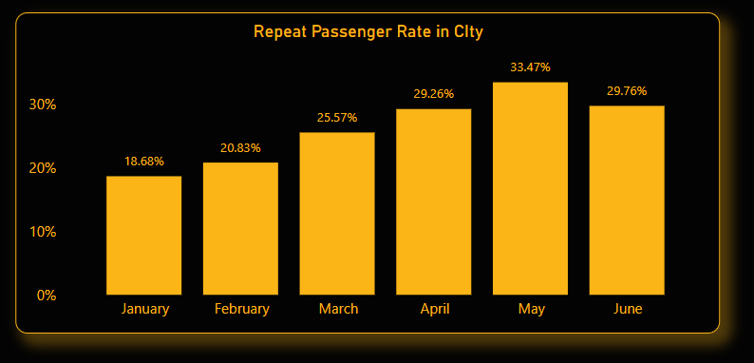
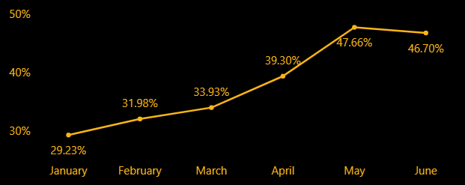
Primary Insights
8. Highest and Lowest Repeat Passenger Rate (RPR%) by City and Month
By City:
Surat
Lucknow

Slide 30
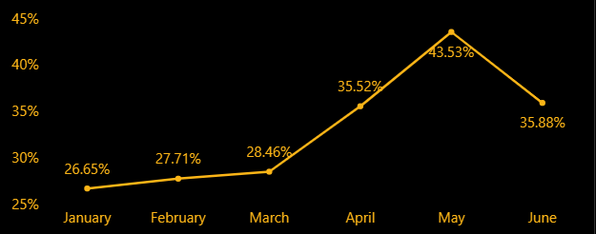
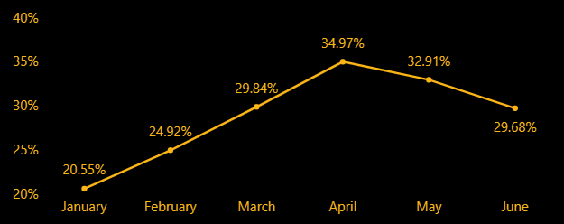
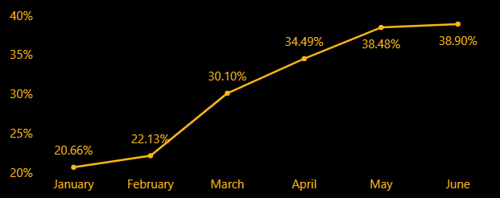
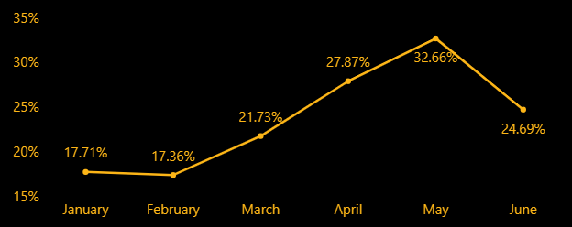
Primary Insights
By City:
Indore
Visakhapatnam
Vadodara
Coimbatore

Slide 31
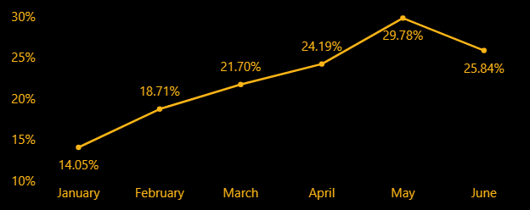
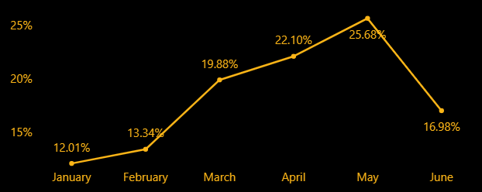
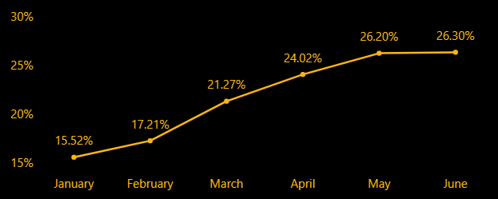
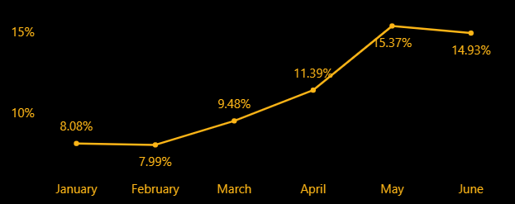
Primary Insights
By City:
Kochi
Jaipur
Chandigarh
Mysore

Slide 32
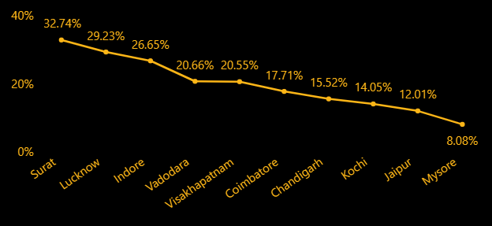
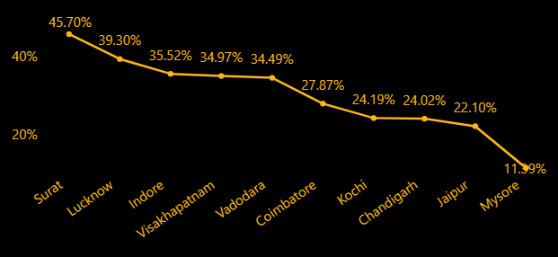
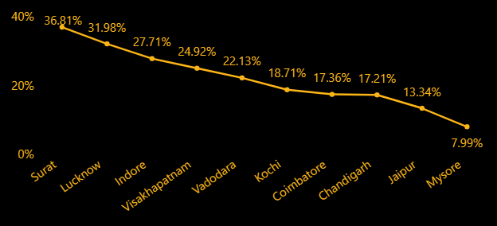
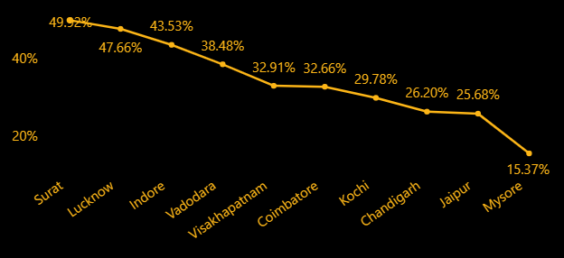
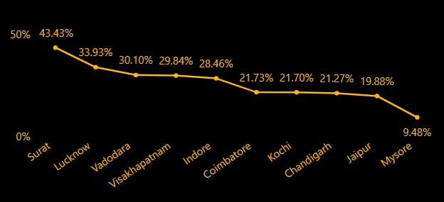

Primary Insights
By Month:
January
April
February
May
March
June

Slide 33
Primary Insights
Analysis of Repeat Passenger Rate (RPR%)
By City:
Top 2 Cities:
Surat: Highest RPR% at 49.92% in May.
Lucknow: Second highest RPR% at 47.66% in June.
Bottom 2 Cities:
Mysore: Lowest RPR% at 7.99% in February.
Jaipur: Second lowest RPR% at 12.01% in January.
By Month:
Highest RPR%:
May: Highest RPR% at 33.47%.
Lowest RPR%:
January: Lowest RPR% at 18.68%.
Seasonal Patterns:
The analysis shows that repeat passenger rates are higher in May and lower in January, indicating potential seasonal influences on passenger loyalty. Surat and Lucknow exhibit the strongest repeat passenger rates, while Jaipur and Mysore have the weakest rates, which could reflect local operational differences or customer engagement levels.

Slide 34
Further Analysis and Recommendations
Factors Influencing Repeat Passenger Rates
Q: What factors (such as quality of service, competitive pricing, or city demographics) might contribute to higher or lower repeat passenger rates in different cities? Are there correlations with socioeconomic or lifestyle pattems in these cities?
1. Quality of Service
Customer Experience: Timeliness, cleanliness, and ease of booking services significantly impact customer retention.
Personalization: Tailoring services to local preferences (e.g., language support) can enhance repeat rates.
Reliability: The availability of options during peak hours or festivals is crucial.
2. Competitive Pricing
Affordability: Cities with a higher proportion of price-sensitive populations may demand lower costs for higher repeat rates.
Dynamic Pricing Models: Flexible pricing during peak times may deter passengers if perceived as unfair.
3. City Demographics
Each city's unique demographics can shape repeat passenger behavior:
Jaipur
Tourism-centric: A significant inflow of tourists may lead to higher single-use passengers compared to locals.
Service Quality Focus: Locals may value reliable transport for daily commutes.
Lucknow
Cultural Hub: Affordable and culturally aligned services can foster repeat usage.
Economic Diversity: Diverse income groups mean segmentation of services might be key.
on convenience and punctuality might perform well.
Pricing Sensitivity: A high proportion of blue-collar workers may lead to higher sensitivity to price changes.

Slide 35
Further Analysis and Recommendations
Kochi
Tourism & Trade: Efficient connectivity to key business and tourism areas might drive loyalty.
Cultural Alignment: Incorporating local cultural elements in service (e.g., Malayalam language options) can appeal.
Indore
Tier-II Growth: Rising aspirations of the middle-class population might demand higher quality services at competitive prices.
Educational Hub: Services catering to students might drive frequent usage.
Chandigarh
Urban Planning: High urbanization and a structured layout may necessitate premium but reliable services.
Affluent Population: Luxury and premium features might have more takers.
Vadodara
Cultural and Industrial Mix: A mix of working professionals and families might require diverse service options.
Affordability Focus: Price-sensitive middle-class families dominate the landscape.
Visakhapatnam
Port and Industry: Business travelers and industrial workers might drive demand for robust and punctual services.
Tourist Appeal: Coastal tourism might also lead to periodic passenger surges.
Coimbatore
Textile Industry Hub: Regular travel by workers and business owners might demand reliable and economical options.
Lifestyle Preferences: Health-conscious residents might appreciate eco-friendly or green initiatives.
Mysore
Tourism and Heritage: Tourists may dominate non-repeating passenger numbers, but locals might prefer reliable and affordable travel.
Education Hub: Services focused on student convenience might perform better.

Slide 36
Further Analysis and Recommendations
4. Socioeconomic and Lifestyle Correlations
Income Levels: Wealthier cities (e.g., Chandigarh) might see higher repeat rates for premium services, while cities with mixed income levels (e.g., Surat, Lucknow) may lean towards affordability.
Commuting Culture: In cities where public transport is less prevalent, the use of private services or shared mobility could be higher.
Lifestyle Trends: Health-conscious or environmentally aware cities (e.g., Coimbatore) might favor sustainable and innovative mobility options.
Festival and Event Patterns: Seasonal surges in some cities (e.g., Jaipur, Mysore) may skew repeat passenger trends.

Slide 37
Further Analysis and Recommendations
2. Tourism vs. Business Demand Impact
Q: How do tourism seasons or local events (festivals, conferences) impact Goodcabs' demand patterns? Would tailoring marketing efforts to these events increase trip volume in tourism-oriented cities?
Tourism seasons and local events, such as festivals and conferences, significantly influence demand patterns for Goodcabs. During peak tourism seasons, cities with a strong tourism focus often experience a surge in trip volume due to an influx of visitors requiring transportation. Similarly, local events like conferences or exhibitions create temporary demand spikes as business travelers seek reliable commuting options.
Tailoring marketing efforts to align with these periods can indeed help Goodcabs capitalize on demand. For instance:
Tourism-Oriented Cities:
  Collaborate with hotels, travel agencies, and tourism boards to promote Goodcabs as the preferred transport solution for tourists.
  Offer seasonal discounts, guided city tour packages, or exclusive event-related services during festivals like Diwali, Holi, or local fairs.
Business-Oriented Cities:
  Partner with event organizers and conference centers to provide shuttle services for participants.
  Introduce loyalty programs or corporate packages for frequent business travelers.
By leveraging these demand variations, Goodcabs can not only enhance trip volumes but also improve brand visibility and customer loyalty in both tourism- and business-driven markets.

Slide 38
Further Analysis and Recommendations
3. Emerging Mobility Trends and Goodcabs' Adaptation
Q: What emerging mobility trends (such as electric vehicle adoption, green energy use) are impacting the cab service market in tier-2 cities? Should Goodcabs consider integrating electric vehicles or eco-friendly initiatives to stay competitive?
Emerging mobility trends such as the adoption of electric vehicles (EVs), green energy initiatives, and an increasing preference for sustainable transportation are reshaping the cab service market, especially in tier-2 cities. These trends present both opportunities and challenges for Goodcabs. Here's an analysis of the trends and recommendations:
Key Mobility Trends in Tier-2 Cities:
Electric Vehicle (EV) Adoption:
  With government incentives, subsidies, and EV-friendly policies, tier-2 cities are witnessing a gradual increase in EV adoption.
  Customers are becoming more eco-conscious, preferring cab services that reduce their carbon footprint.
Green Energy Initiatives:
  Cities are focusing on improving air quality and promoting green energy, such as solar charging stations and reduced emissions from vehicles.
Digital and App-based Innovations:
  Customers expect modern features like app-based booking, real-time trip tracking, and cashless payment options.

Slide 39
Further Analysis and Recommendations
Should Goodcabs Adapt?
Yes, integrating EVs and eco-friendly initiatives can help Goodcabs stay competitive and build a strong brand image. Here’s how:
Short-term Strategies:
Pilot EV Programs:
  Introduce a small fleet of electric cabs in high-demand cities to test operational efficiency and gather customer feedback.
  Partner with EV manufacturers and government bodies for subsidies and financial support.
Eco-friendly Marketing Campaigns:
  Highlight Goodcabs' commitment to sustainability through campaigns promoting green energy and clean transportation.
Long-term Strategies:
Transition to EVs:
  Gradually expand the EV fleet in tourism-focused or high-pollution cities where demand for eco-friendly options is higher.
  Install partnerships with charging station providers to reduce infrastructure challenges.
Incentivize Drivers:
  Provide incentives for drivers to switch to electric vehicles, such as reduced lease rates or charging benefits.
Customer Engagement:
  Offer discounts or rewards for customers choosing EV rides, encouraging them to support green initiatives.
By adopting these strategies, Goodcabs can position itself as a forward-thinking, environmentally conscious brand, ensuring competitiveness in the evolving cab service market of tier-2 cities.

Slide 40
Further Analysis and Recommendations
4. Partnership Opportunities with Local Businesses
Q: Are there opportunities for Goodcabs to partner with local businesses (such as hotels, malls, or event venues) to boost demand and improve customer loyalty? Could these partnerships drive more traffic, especially in tourism- heavy or high-footfall areas?
Opportunities for Partnerships:
Hotels and Resorts:
  Tourism Boost: Collaborating with hotels and resorts in tourist-heavy cities can attract travelers who need reliable transportation services for sightseeing, airport pickups/drop-offs, or day trips.
  Value-added Packages: Offer bundled packages (e.g., discounted cab services for hotel guests) to make the partnership attractive.
Malls and Shopping Centers:
  High Footfall Areas: Malls experience a surge in foot traffic during weekends, holidays, and sales events, creating a demand for convenient transportation.
  Increased Brand Visibility: Co-branded kiosks or designated Goodcabs pickup/drop-off zones at mall entrances can improve visibility and accessibility.
Event Venues (Conferences, Festivals, Stadiums):
  Large-scale Events: Partner with event organizers to provide pre-arranged transportation for attendees, ensuring seamless travel.
  Seasonal Peaks: During festivals, weddings, or local cultural events, demand for transportation spikes, offering a lucrative opportunity for targeted campaigns.
Airports and Railway Stations:
  Seamless Connectivity: Collaborating with airports or railway stations can position Goodcabs as the go-to service for first-mile and last-mile connectivity.

Slide 41
Further Analysis and Recommendations
Benefits of Partnerships:
Boosted Demand:
  Exclusive partnerships can drive significant ride volume during peak travel and shopping seasons.
  Tourists and event attendees will prefer a trusted, accessible transportation service.
Improved Customer Loyalty:
  Co-branded campaigns or loyalty programs tied to partner businesses can encourage repeat usage.
  Offering promotional discounts to customers of partner businesses fosters goodwill.
Enhanced Competitive Edge:
  Establishing exclusive partnerships differentiates Goodcabs from competitors and builds a reputation as a reliable service provider.
Recommended Partnership Strategies:
Short-term Actions:
Customized Offers:
  Provide discount codes or cashback for partner business customers (e.g., a 10% discount on rides for hotel guests or mall shoppers).
  Launch limited-time promotions during festivals or high-footfall periods.
Dedicated Pickup/Drop Zones:
  Collaborate with malls, hotels, and event venues to establish exclusive Goodcabs parking or waiting areas, ensuring convenience for customers.
Co-branded Marketing:
  Run joint marketing campaigns with partners, such as advertisements on hotel websites or posters at event venues.

Slide 42
Further Analysis and Recommendations
Long-term Actions:
Integrate Services:
  Allow hotel or mall apps to integrate Goodcabs booking functionality directly, streamlining the customer experience.
  Introduce subscription-based services for frequent visitors or business travelers.
Loyalty Program Collaboration:
  Link Goodcabs' loyalty program with partner businesses, offering mutual rewards (e.g., Goodcabs ride credits for hotel stays or mall purchases).
Expand Regional Networks:
  Focus partnerships in high-demand cities or regions to maximize the impact of collaborations with tourism-heavy or high-traffic businesses.

Slide 43
Further Analysis and Recommendations
5. Data Collection for Enhanced Data-Driven Decisions
Q: To make Goodcabs more data-driven and improve its performance across key metrics (such as repeat passenger rate, customer satisfaction, new passengers and trip volume), what additional data shouId Goodcabs collect? Consider data that could provide deeper insights into customer behaviour, operational efficiency, and market trends.
Customer Behavior Data
Understanding customer preferences and travel patterns will enable targeted marketing and service improvements:
Update fact_passenger_summary data:
  Add date as well in the fact_passenger summary in order to know more about weekend and weekday passenger summary.
  also
Trip Purpose and Timing:
  Collect data on whether trips are for business, leisure, or other purposes.
  Track peak hours and seasonal demand patterns to optimize fleet allocation.
Feedback and Ratings:
  Capture detailed ride feedback on various aspects like comfort, punctuality, and driver behavior.
  Introduce post-ride surveys to measure satisfaction and areas of improvement.
Booking Preferences:
  Analyze data on booking channels (mobile app, website, or partner integrations).
  Study preference for scheduled vs. on-demand rides.

Slide 44
Further Analysis and Recommendations
2. Operational Efficiency Data
Gathering detailed operational metrics can highlight bottlenecks and improve service quality:
Driver Performance:
  Track metrics such as acceptance rates, on-time arrivals, and ride completion rates.
  Collect data on driver feedback from passengers for training and rewards.
Vehicle Usage:
  Monitor vehicle mileage, fuel consumption, and maintenance needs.
  Record downtime and repair history to ensure fleet availability.
Ride Patterns:
  Collect data on trip cancellations, no-shows, and reassignments to identify inefficiencies.
3. Market and Competitor Trends
Stay ahead of market demands and competition by analyzing external data:
Pricing Competitiveness:
  Gather data on competitors’ pricing and service offerings.
  Compare dynamic pricing adjustments during peak hours or special events.
Local Event Data:
  Track festivals, conferences, and public events to forecast demand surges.
Customer Demographics:
  Collect demographic data (age, occupation, income range) to tailor services for specific groups.

Slide 45
Further Analysis and Recommendations
4. Additional Key Metrics
Enhance Goodcabs’ ability to act on performance data by tracking:
Repeat Passenger Metrics:
  Identify the frequency and recency of trips by repeat customers to design retention strategies.
Churn Indicators:
  Track customers who stopped using Goodcabs after their first ride.
  Collect data on reasons for churn (e.g., pricing, service quality, or competition).
Referral Data:
  Record referrals and analyze patterns to measure organic growth and customer loyalty.
Recommended Tools for Data Collection:
Mobile App Analytics: Track user behavior and preferences.
CRM Systems: Capture customer feedback, booking history, and loyalty program participation.
IoT and GPS Tracking: Use GPS for live vehicle monitoring and driver performance data.
Survey Tools: Regularly collect customer and driver feedback via surveys or app prompts.

Slide 46
Conclusion
Goodcabs is positioned to become a leader in tier-2 city cab services by continuing its commitment to supporting local drivers, enhancing passenger satisfaction, and achieving ambitious growth targets. By leveraging feedback, optimizing operations, and maintaining a focus on quality, the company is set to achieve a successful and sustainable future.
Goodcabs aims to increase its operations from 10 to 15 tier-2 cities by the end of 2025. The company targets a 25% rise in trip volume, a 20% increase in repeat passenger rate, and achieving passenger satisfaction scores above 90%. By focusing on data-driven strategies, operational optimization, and driver empowerment, Goodcabs is setting the stage for a transformative impact on local mobility solutions in tier-2 cities.

Slide 47



